Slide 1
WEBMONK (COURSE DAY - 8)
Topics covered:
* Server side rendering (SSR)
* Client side rendering (CSR)
* SSR vs CSR
* JWT authentication

Slide 2
SERVER SIDE RENDERING (SSR)

Slide 3
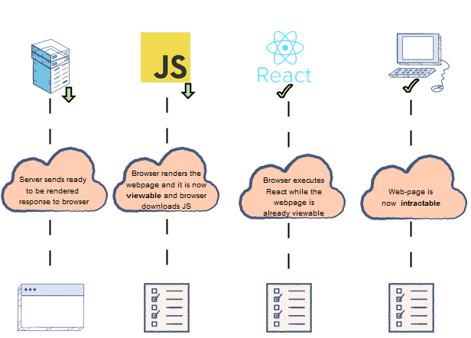
INTRODUCTION
* Server-side rendering (SSR), is the ability of an application of building the web-page on the server instead of building & rendering it in the browser
* Server-side sends a fully rendered page to the client
* Ex: Ejs, Nuxt.js, Next.js, JSP etc.

Slide 4
CLIENT SIDE RENDERING (CSR)

Slide 5
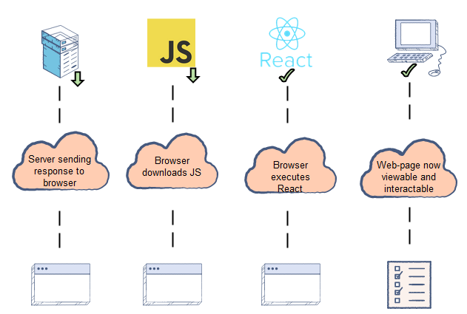
INTRODUCTION
* Client Side Rendering (CSR) is the ability of an application of rendering the content in the browser using JavaScript. So instead of getting all of the content from the HTML document itself, browser get a bare-bones HTML document with a JavaScript file that render the rest of the site in the browser.
* CSR is a relatively new approach to rendering websites as JavaScript got more powerful and extensive.
* Ex: React.js, Vue.js, Angular

Slide 6
SSR vs CSR

Slide 7
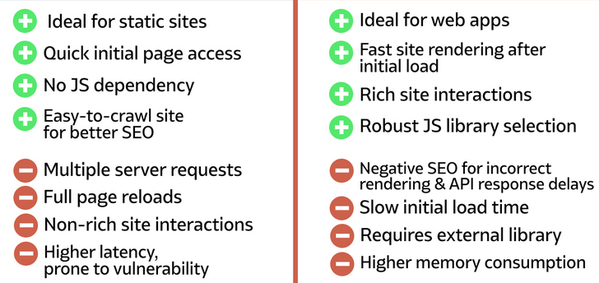
SSR vs CSR

Slide 8
JSON WEB TOKEN (JWT)

Slide 9
JWT
* JSON Web Token (JWT) is an open standard that defines a compact and self-contained way for securely transmitting information between parties as a JSON object.
* Here are some scenarios where JSON Web Tokens are useful:
* Authorization: Once the user is logged in, each subsequent request will include the JWT, allowing the user to access routes, services, and resources that are permitted with that token. Single Sign On is a feature that widely uses JWT nowadays, because of its small overhead and its ability to be easily used across different sub-domains.
* Information Exchange: JSON Web Tokens are a good way of securely transmitting information between parties. Because JWTs can be signed—for example, using public/private key pairs—you can be sure the senders are who they say they are. Additionally, as the signature is calculated using the header and the payload, you can also verify that the content hasn't been tampered with.

